Slide 1
New Special Education Teacher Training August 9, 2019

Slide 2
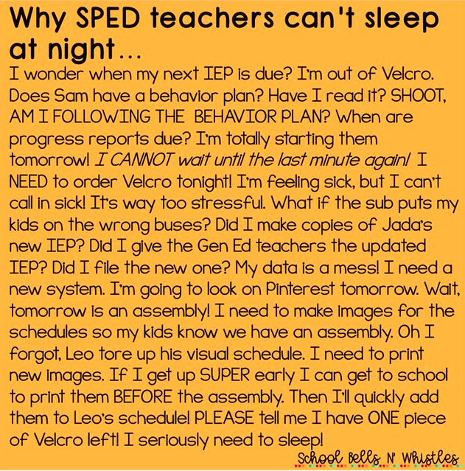

Slide 3
Introductions
&
Sharing

Slide 4
Programming Options in DPISD
QR Codes Handout (important)

Slide 5
DPISD Website Resources
DPISD Operating Guidelines
Staff Portal
DPISD SPED Weebly http://deerparksped.weebly.com/

Slide 6
Levels of Support
Decision Making guide
Impact statement guiding questions
Assistive technology

Slide 7
Your Role-Case manager responsibilities
ARD Meetings
- Annual ARD Checklist
“10 Things You Never Say”

Slide 8
Where Do I Go for Help?

Slide 9
Campus Resources
Campus CTIS – Technology support
eSped Representatives (William Horton & Hayley Hearn)
Department Chair/Mentor
LSSP / Diagnostician
Counselor
Administrator
Coordinators for Special Services
(Secondary = Misti Mead & Elementary = Michele Deutschendorf)

Slide 10
eSped Information

Slide 11
Upcoming training
Co-Teach New Pairs – August 19, 2019 Full Day
IEP Goal Development – PLAAFP & IEP Goals (ONLINE: region 20 - complete by September 9, 2019)
Co-Teach Returning Pairs – September 16th , 2019 AM or PM session
Schedule of Services, transportation & IEP Amendments (September 17th 1:30-3:30 & October 1st 8:00-10:00)
Transition (secondary only)- with Michelle Wright

Slide 12
Classroom management:

Slide 13
Top 10 Ways to Make Sure You’ll Have a Good Year!

Slide 14
# 10
Be on time and don’t leave early.

Slide 15
# 9
Play nicely with your co-workers.

Slide 16
# 8
Follow your campus rules:
cell phones put away
no tats showing
etc

Slide 17
# 7
Complete paperwork on time and be prepared for ARD meetings.

Slide 18
# 6
Read the FIE and IEP information on your students.

Slide 19
# 5
Be kind to your campus custodians.

Slide 20
# 4
Have regular contact with your students’ parents.

Slide 21
# 3
Never confuse sarcasm with humor.

Slide 22
# 2
Try teaching it a different way for the students who didn’t get it the first five times.

Slide 23
# 1
EVERY CHILD MATTERS

