Slide 1
Accommodations and Modifications
SPEED LIMIT
55
Special Education 101
2018

Slide 2
Every Road Leads to the DESTINATION
FIE -Review Information from the FIE that is helpful to include in PLAFFP and making decisions
PLAAFP - Use Various forms of data to identify Critical Areas of Need that will be addressed through annual goals.
IEP
Goals/Objectives - Written in order to address the critical areas of need that were identified in the PLAAFP
Accommodations/
Modifications - What is needed for the student to access the general education curriculum?
- Has the complexity been changed in a way that the content is modified?

Slide 3
http://iris.peabody.vanderbilt.edu/module/acc/challenge/#content
Initial Thoughts:
Jot down your initial thoughts about the challenge:
What should teachers know about accommodations for students with disabilities?
What types of accommodations are commonly used for students with disabilities?
What are the teacher’s responsibilities for students with disabilities who use accommodations?

Slide 4
Understanding Accommodations
Although most students with disabilities are able to learn in the general education classroom, sometimes a student’s disability gets in the way of their capacity to learn the material or to demonstrate skills. A student with a traumatic brain injury might have difficulty staying focused, just as a student with a learning disability might experience trouble reading. Regardless of such barriers, these students are able to learn the curriculum but, they might require adaptations/supports.
Two types of adaptations/supports are:
accommodations and modifications
Adaptations provide students with opportunities to achieve the same outcomes and benefits as students without disabilities!

Slide 5
Questions to Consider
Accommodation
What is needed to enable the student to access the knowledge in the general education curriculum?
Modification
Has the complexity of the material been changed in a way that the content has been modified?

Slide 6
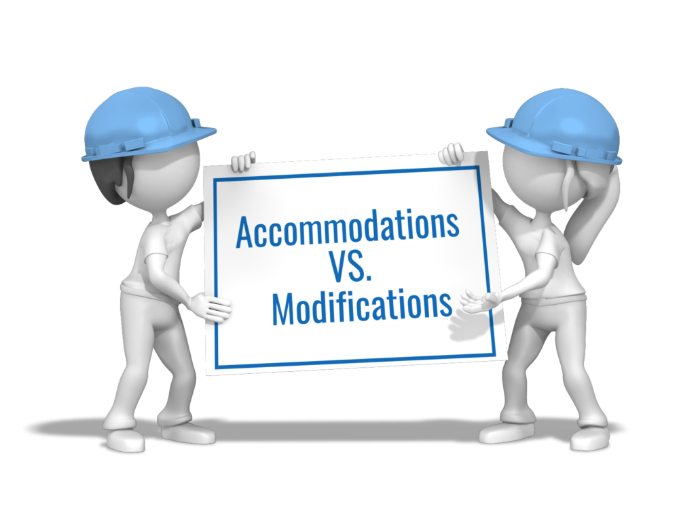
HOW
WHAT
Accommodations
(no change in complexity)
Provide equal access to curriculum
Do not change the expectations for learning
Do not reduce the requirements of the task
Examples: calculator, supplemental aids, text-to-speech, language and vocabulary supports, content supports, extra time, etc.
Modifications
(changes the complexity)
Allow students the opportunity to participate actively and productively in classroom instruction
Do change the expectations for learning
Do reduce the requirements of the task (e.g., reduce number of items, alternate assignments, lower-level reading assignments)
more support/adjustments than accommodations

Slide 7
Secondary Students
Important considerations when recommending MODIFIED CURRICULUM:
Special Education Graduation Requirements (Foundation)
Chapter 89. Adaptations for Special Populations
(c) A student receiving special education services may earn an endorsement under §74.13 of this title (relating to Endorsements) if the student:
(1) satisfactorily completes the requirements for graduation under the Foundation High School Program specified in §74.12 of this title as well as the additional credit requirements in mathematics, science, and elective courses as specified in §74.13(e) of this title with or without modified curriculum;
{DPISD: The interpretation is that yes students can receive modifications on any course that is required for the Foundation 22 as well as the additional math, science and 2 electives that are required to earn an endorsement. The pathway courses specific to an endorsement cannot be modified. (Example: agriculture, finance, etc.)}
(2) satisfactorily completes the courses required for the endorsement under §74.13 (f) of this title without any modified curriculum; and
{Courses that are needed to satisfy both a requirement under the Foundation and an endorsement cannot be modified. (Example: math, English, science, or social studies if these courses are being used to fulfill requirements for the following endorsements: All STEM, Multidisciplinary: 4X4, Arts & Humanities: Social Studies, or Business & Industry: English}

Slide 8
Instructional Accommodations:
Changes made to the delivery of classroom instruction or to the accompanying materials.
TEKS are not changed
Complexity = same as peers
Content = same level of proficiency as peers
Teachers should know their students’ needs. When they are knowledgeable, teachers are more likely to recognize when instructional accommodations are necessary and when accommodations might need to be changed. They are also less likely to create an overdependence on an accommodation.
Testing Accommodations:
Changes that do not affect what a test measures.
Format of a test (ex. On-line)
Administration procedures (ex. oral administration, extra time, content & language supports…)
Sometimes allowable in one condition but not in another (classroom vs. state assessment)
Teachers sometimes believe that testing accommodations constitute an unfair advantage. When they are used appropriately, though, this should not be the case. In fact, if students without disabilities used the same accommodations, their scores with and without them should be the same.
Instructional Accommodations vs Testing Accommodations

Slide 9
Presentation
Visual
Large print books and materials
Magnifying devices
Place marker
Note-taker
Reduction of visual clutter
Language & Vocabulary Supports
Content Supports
Auditory
Amplification devices
Audio books
Oral reader (text to speech)
Tactile
Braille text
Manipulatives
Tactile graphics (raised line maps, charts, graphs or paper)
Response
Write answers in test booklet rather than separate paper
Use computer to do work
Augmentative communication device for verbal responses
Speech-to-text
Use a scribe
Record responses
Braille writer
Circle or point to answers
Use spell/grammar checker
Calculator
Graphic organizer
Manipulatives
Note-taker
Setting
Environment Changes
Supply adaptive furniture and equipment
Adjust table height for students in wheelchairs
Provide appropriate seating for student size or positioning
Eliminate or minimize visual/auditory distractions
Preferential seating
Use of noise reduction headphones
Permit students to work individually or with a group/partner
Individual/small group testing arrangements
Timing and Scheduling
Helps reduce stress/fatigue
Provide breaks as needed
Extended time to complete assignments
Provide a timeline for completing tasks
Break large tasks into smaller parts
Use a timer
Shorten testing sessions
Schedule instructional activities when student is more alert and engaged
Commonly Used Accommodations

Slide 10
Modification/Accommodation
Tips 101
Never give answers or do the work for the student.
If you are unsure whether you are modifying too much, go with it, see how the student responds, then do it differently next time.
Reword, interpret, or translate difficult questions on worksheets and difficult passages in instructional materials. (clarify difficult vocabulary)
Provide a word bank to help stimulate thoughts, fill in blanks, and form sentences. Choose the important words and concepts for class discussions, worksheets, notes and keywords in the textbook.
Instructional information can be categorized as (1) must know, (2) nice-to know, or (3) trivia knowledge or extension information. When necessary, prioritize instructional information in this order and begin reinforcing the must-know information. (Modified Curriculum) (Supporting and Readiness Standards)
Prioritize the concepts in your instruction, and use that order to present materials to certain students.
Having information read aloud, providing extra time and allowing oral answers are classic instructional accommodations.
Reviewing or previewing vocabulary and general statements about an instructional topic is very helpful.
Devise nonverbal visual cues, hand signals, jingles, rap songs, mnemonics- anything to help students remember information.
Routinely provide and teach students how to use and apply supplemental aids/charts such as: calculators, blank graphic organizers, math charts, etc. during instruction and when testing.
Practice and teach students strategies for testing on-line – note taking or annotating on scratch paper or post it notes, go back and review or re-read text, etc.

Slide 11
Teacher Role
For students who receive special education services, the decision to use accommodations for instruction and testing is made by the admission, review and dismissal committee (ARD) committee. Because teachers have first-hand knowledge of what works with the student in their classrooms, they are valuable members of the ARD committee.
In order to make accommodation decisions for students, educators should have knowledge of the TEKS and how a student performs in relation to them. Accommodations are reviewed annually during the IEP meeting, or more often if needed.
Once a teacher begins to provide the accommodations, he or she should monitor whether they are proving effective. Doing so can determine whether to continue, alter, or discontinue accommodations. A student who is unaccustomed to using a particular accommodation might be hindered rather than helped by an accommodation not routinely used. This does not mean that the accommodation must be used every day during instruction. Routine accommodation use, as defined by TEA result in two important outcomes.
Student has used the accommodation often enough during instruction and testing that he/she is able to use it independently during state assessment.
The accommodation has proven to be effective in meeting the student's specific needs, as evidenced by the student scores or teacher observations with and without accommodation use.
In the event that accommodations require alteration, the IEP team should meet to document the changes on the student’s ARD forms.
Teacher Responsibilities

Slide 12
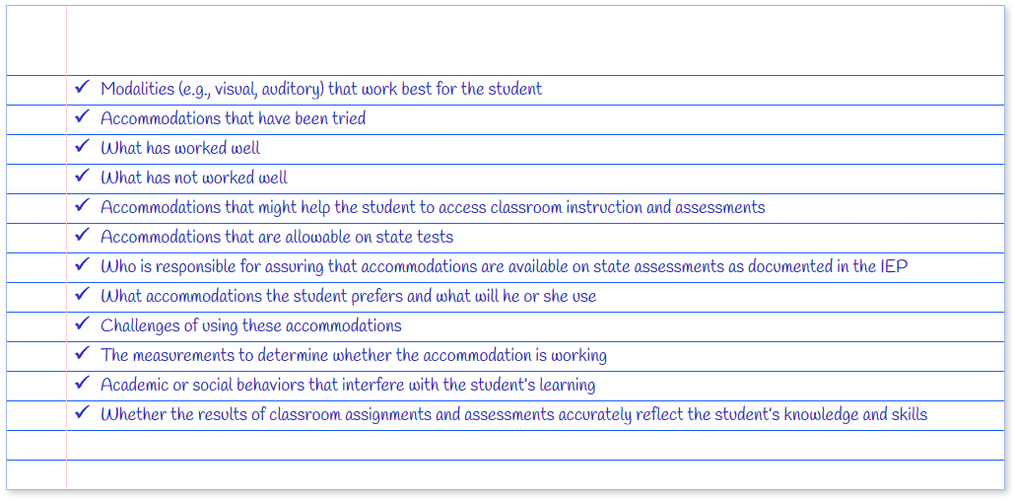
Accommodation decisions are individualized to the student and should not be based on a specific disability category, the list below offers some items that might be considered or discussed.

Slide 13
Assessment
Accommodations
(Designated Supports)
Classroom Instruction
State and District Assessment
Classroom Assessment
It is important that accommodations recommended for students align between classroom instruction, classroom testing and district or state tests.
Students need opportunity to learn to use accommodations in the classroom and also take classroom tests using those accommodations
Classroom testing accommodations should be as close as possible to those of district or state testing situations to increase a student’s comfort level and allow for the best possible performance.
Accommodations for assessment and instruction are integrally intertwined
Some accommodations are appropriate for classroom use but not appropriate in testing situations
NO Accommodation should be recommended for an assessment that a student has not had the opportunity to use routinely and effectively
Get Student Input! Ask what would be most helpful?
Every student with a disability does not need an accommodation, nor do all students with the same disability need the same accommodations
Decisions are INDIVIDUALIZED (hence the “I” in IEP)

Slide 14
Accommodation Resources
https://tea.texas.gov/accommodations/

Slide 15
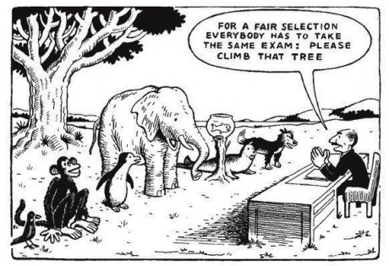

Slide 16
Accessibility Features for
ALL students
Include things that may be provided to students based on their needs. In general, these procedures and materials are available to any student who regularly benefits from the use of these procedures or materials during instruction. (no eligibility requirements)
You are not required to document these on the STAAR accommodations
General Reminders to Stay on Task | Third Grade Math Reading Assistance | Read Aloud Writing Prompt to Student
Scratch Paper, Sticky Notes (added to online) | Color overlay/ online color setting | Read Test Aloud to Self
Highlighters (included online), colored pencils, or crayons | Signing test administration directions | Small Group Administration
Individual Administration | Blank Place Marker/Guideline Tool | Magnifying Devices/Zoom Feature
Tools to Minimize Distractions or help maintain focus | Translating test administration directions | -Dictionary- bilingual -See dictionary policy for more guidance on ALL dictionary questions
Amplification Devices | Projection Devices | Reminders to stay on task

Slide 17
STAAR Alt 2 - participation requirements
Must meet ALL 5 criteria!
Does the student have a significant cognitive disability?
A determination of significant cognitive disability is made by the ARD committee and must be based on the student’s most recent full and individual evaluation (FIE) conducted by the multidisciplinary team that includes a LSSP, diagnostician or other appropriately certified or licensed practitioner with experience and training in the area of the disability. AND
Results from the FIE must indicate a deficit in the student’s ability to plan, comprehend, and reason. FIE results must also indicate adaptive behavior deficits that limit a student’s ability to apply social and practical skills such as personal care, social problem-solving skills, dressing and eating, using money, and other functional skills across life domains. It is unlikely to see these types of results in an FIE of a student with a high-incidence disability only, such as a specific learning disability or speech impairment.
2. Does the student require specialized, extensive supports to access the grade-level curriculum and environment?
Federal regulations mandate that all students have access to grade-level curriculum. A student with a significant cognitive disability requires extensive, repeated, specialized supports and materials beyond the support typical peers require. The student uses substantially modified materials to access information in alternate ways to acquire, maintain, generalize, demonstrate and transfer skills across all settings. AND
A student with a significant cognitive disability demonstrates adaptive behaviors that are significantly impaired. This most likely will impact the student’s ability to live independently and will require specialized supports for the student to function safely in daily life across all life domains, not just the school environment.
3. Does the student require intensive, individualized instruction in all instructional settings?
A student with a significant cognitive disability requires a highly specialized, individualized curriculum linked to functional and academic IEP goals and objectives. AND
A student with a significant cognitive disability requires classroom assessments administered in alternate or non-traditional methods to demonstrate acquisition, maintenance, and generalization of discrete skills across academic settings. AND
A student with a significant cognitive disability requires individualized instruction that is neither temporary nor limited to specific content areas.
4. Does the student access and participate in the grade-level TEKS through prerequisite skills?
A student with a significant cognitive disability requires a highly specialized educational program with intensive supports and modification to the curriculum to access the TEKS through prerequisite skills that are significantly below grade-level instruction. For instance, an elementary student may be 3-4 levels below grade-level instruction wile a student in HS ma be 7-9 levels below.
5. Is the STAAR Alternate 2 assessment determination based on the student’s significant cognitive disability and NOT on any other factors?
The decision to administer STAAR Alt 2 is NOT based on a student’s racial or economic background, English learner status, excessive or extended absences, location of service delivery, anticipated disruptive behavior or emotional distress, or any other such factors.

Slide 18
Assessment Options for
Students with Disabilities
STAAR online or STAAR on paper & STAAR Alt 2
ARD committee decides either paper STAAR or STAAR online. (these decisions are made on an individualized basis and must be documented in IEP)
STAAR online will be comparable to the features that were included in STAAR except with individualized Embedded Accommodations.
Students may qualify for any combination of the embedded designated supports based on the eligibility requirements outlined by TEA.
All supplemental aids that are allowable on a paper test can also be used for online test.
See slide 17 for STAAR Alt 2 Participation Requirements
(Students must meet eligibility for these embedded supports)
STAAR Online | Text-to-speech | Content & Language Supports | Spelling Assistance

Slide 19
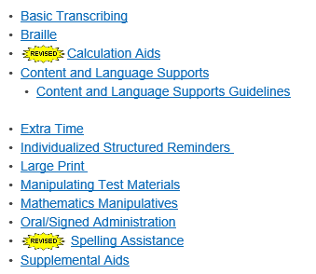
Accommodations guidelines: Designated Supports
https://tea.texas.gov/accommodations/
Designated Supports: These are locally-approved supports for students who meet eligibility criteria.
Designated Supports Requiring TEA Approval: These supports require the submission and approval using the Accommodation Request Process.
*3-7 math basic calculator only (no graphing/scientific
*Oral admin – paper test for writing/Eng can read revision passages and revision Q & A

Slide 20
Accommodations guidelines:
Content and Vocabulary Supports
(How does this accommodation relate to classroom accommodations & strategies?)
Pop-ups
isolate specific information in a question that corresponds to each answer choice
isolate specific text or information in a selection that is referenced in the question or answer choices
isolate specific information in a graphic or list that is referenced in the question
Define literary terms
apply an allowable supplemental aid (e.g., graphic organizer, place-value chart, t-chart, graphic of scientific concept, timeline, map) to specific questions or answer choices
include the formula from the grade-specific Reference Materials when the question specifies the measure or conversion to be performed
direct student attention to parts of the grade-specific Reference Materials
provide clarifying information for a graphic organizer, political cartoon, or map
provide a visual representation in the selection, question, answer choices, or in the writing prompt by adding graphics, photographs, or animations
define or clarify construct-irrelevant words, phrases, and sentences using plain language, synonyms, definitions, examples, and consistent language
Rollovers
bullet or separate steps in a process (e.g., multi-step problem, sequence of events)
reword complex question or answer choices to condense text
Reorganize and simplify historical excerpts
Prereads
Offer text prior to the selection (for grades 3-8 reading, grades 4 and 7 writing, English I, and English II only)
Supplementary Material
blank Punnett squares (biology only)
writing checklists (for grades 4 & 7writing , English I, and English II only)

Slide 21
Tips for Teachers
When accommodations are documented on a student’s IEP, teachers are required to provide them. Therefore, it is important for teachers to plan for and use identified accommodations during instruction and testing.
To maximize the student’s success with accommodations, teachers can:
Become familiar with each student’s needs:
Know the student’s strengths and weaknesses.
Learn about each student’s equipment needs (e.g., software, hardware).
Allow the student time to practice using accommodations with content that comes more readily to them so they are not struggling with new content and new accommodations at the same time.
Be aware that students using accommodations might require more or less time to complete instructional tasks.
Student perception of the recommended accommodations (e.g., does your student think his accommodation is useful, embarrassing?).
Hold high expectations for the student.
Monitor the student’s progress regularly.
Prepare for testing:
Be familiar with the assessment designated supports allowed by TEA. (Accommodation Resources)
Provide only the testing accommodations listed on the student’s IEP.
Ensure that the student uses and is comfortable with the accommodations prior to testing.
AVOID:
Providing the same accommodation to all because of convenience.
Disregarding an accommodation because only one or a few students need it.

Slide 22
Legal Justification
Accommodation, Modify and Support
Federal Law IDEA §300.323(d) the public agency shall ensure…each teacher and provider is informed of his or her specific responsibilities related to implementing the child’s IEP and the specific accommodations, modifications and support that must be provided for the child in accordance with the IEP.
If not implemented you are denying the student’s right of Free Appropriate Public Education (FAPE)

