Slide 1
JAM Meeting 10/11/18

Slide 2
The Case of the Squirrel’ Nut
Share at your table the nuttiest story of something that has happened this year.

Slide 3
Policy/Procedures/ARD Consent for evaluation who gets it?
Initial FIE
Evaluation Team Lead schedules consent meeting
Process for adding additional assessment staff to an FIE in process
Evaluation Team Leads contact additional staff about evaluation
Evaluation Lead contacts parent to inform him/her about additional assessment
Evaluation Lead amends RFA to add assessment staff
Related Services Evaluation not connected to a FIE or Re-evaluation
Related Service staff contact Evaluation Team lead who creates a RFA
Related Services assessment staff contacts the parent and obtains consent (via phone or in person)
If by phone complete contact logged into eSPED Related Services assessment staff contacts the parent and obtains consent (via phone or in person)
When evaluation is completed Related Services contacts Evaluation Team Lead to arrange for Revision ARD to be held

Slide 4
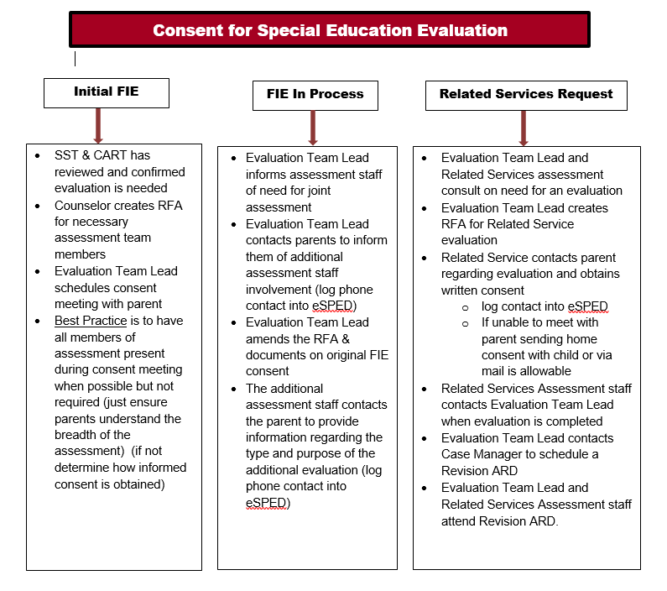

Slide 5
Policy/Procedures/ARD continued
Parent’s Guide to ARD
Before first ARD (at consent mtg.)
Request by parent
Procedural Safeguards
Initial Referral & Request for Evaluations
Filing for Due Process or SE Complaint
Disciplinary Change of Placement
Both in additional languages
http://www.spedtex.org/spedtex-homepage/resources/
Early Childhood Referral for Special Education
https://tea.texas.gov/Academics
Transfer of Rights
Transition
https://tea.texas.gov/interiorpage.aspx?id=2147496883
https://www.transitionintexas.org/Page/143

Slide 6
OT or AT?
Pre-K – 3rd
Learning how to write
Remediation
Low tech
3rd – 5th
If on OT service, OT will request AT
If not on OT, refer for both OT/AT
6th – 12th
Primarily AT referral
Unless parent request, new diagnosis, regression
Common writing referrals
Letter formation
Legibility
Writing speed
Pencil grasp
Spelling
Written organization

Slide 7
Reminder
Parent Request for evaluation
Reminder: Please send Pam a copy of the consent if evaluation is taking place or send PWN of Refusal if evaluation is not taking place.

Slide 8
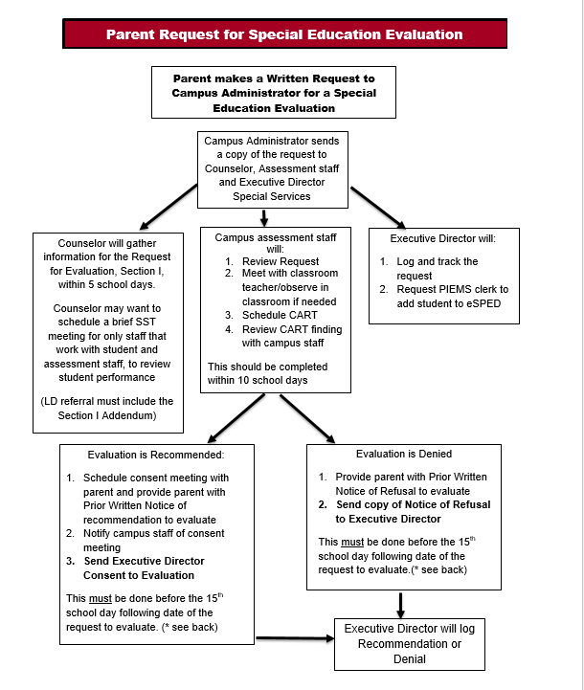

Slide 9
If you have forms that you prefer to be used on an ipad email me the name of or the form so that it can be updated to a PDF template

Slide 10
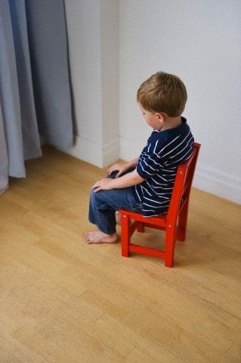
Use of Confinement, Restraint, Seclusion and Time-out

Slide 11
Use of Confinement, Restraint, Seclusion and Time-out
Senate Bill 1196
SE students may not be confined in a locked box, locket closet or specially designed locked space as either discipline or behavior management technique.
LEAs may not place SE students in seclusion as a behavior management technique which confines the student and is designed solely to seclude a person and contains less than 50 square feed of space. (Exception-waiting for law enforcement - weapon)
Restraint – the use of physical force or a mechanical devise to significantly restrict the free movement of all or a portion of a child’s body.
Emergency only – a child’s behavior poses a threat of imminent, serious:
Physical harm to child or others; or
Property destruction
Limited in use
Discontinued when emergency no longer exists
Protects the health and safety of child and others
Not deprive the child of basic human necessities

Slide 12
Use of Confinement, Restraint, Seclusion and Time-out
Time-out – behavior management technique in which, to provide a child with an opportunity to regain self-control, the child is separated from other children for a limited period in a setting
Not locked; and
From which exit is not physically blocked by furniture, closed door held shut from outside or another inanimate object
Time-out may be used when with the following limitations:
Physical force or threat of physical force must not be used to place a child in time-out
Must only be used in conjunction with an array of positive behavior intervention strategies and techniques and must be included in a child’s individual education program or behavior intervention plan
Must not be implemented in a fashion that precludes the ability of a child to be involved in and progress in general curriculum and advance appropriately towards attaining the annual goals

Slide 13
Use of Confinement, Restraint, Seclusion and Time-out
Restraint and Time-out must be documented
Restraints must be recorded in to eSPED as well as Skyward for TEA purposes
Campus administrators must have a copy of the restraint in order to input restraint into Skyward
Time-out must be documented in a students IEP or BIP. The use of time-out must also be documented and data collected to judge the effectiveness of the intervention and provide a basis for making determination regarding its continued use.

Slide 14
Reminders
For an ARD to be held without parent
Promptness
For an ARD to be held without the parent you must have 3 notices on 3 different dates before the ARD can be held without the parent.
All 3 attempts must be documented and turned in with the ARD
Be to trainings and meetings on time
It is not only disruptive to who is leading the meeting and training, but unprofessional when you don’t arrive on time
I will be watching and letting you know when this becomes an issue
In addition, be on time to work
If you are going to be late, make your supervisor aware
Be Prepared for ARDs
Come to ARDs with your “A” game.
Be Prompt
Be Prepared
Be Professional

Slide 15
Section 504
Section 504
LSSPs may need to assist with 504 evaluations for ADHD in the event counselors are unable to get necessary information from the parent/physician
Interpret checklist and provide a statement of condition for the 504 Evaluation.

