Slide 1
The Newly Revised Vineland-3
Online (iPad/Laptop) Administration of the Parent Interview

Slide 2
Adaptive Behavior
Definition: performance of daily activities required for personal and social sufficiency
Notes:
1. Adaptive behavior is age-related.
2. Adaptive behavior can change (can improve or regress).
3. Adaptive behavior is defined by typical performance, not by ability.

Slide 4
Online Administration

Slide 5
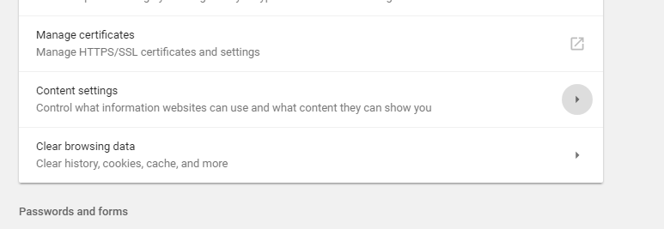
Allow pop-ups for qglobal (Google Chrome)
Under your web browser settings, then Content Settings, then Popups

Slide 6
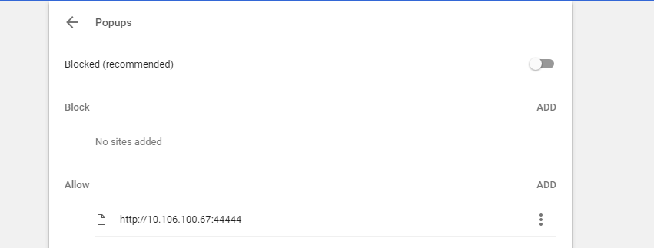
Allow pop-ups for qglobal (Google Chrome)
then Add, and type in the qglobal web address

Slide 7
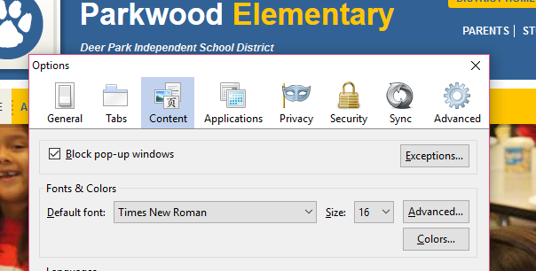
Allow pop-ups for qglobal (Firefox)
Click on ‘Tools’, then ‘Options’
Under the Content tab, click on pop-up window ‘Exceptions’

Slide 8
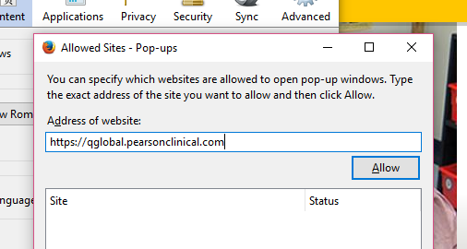
Allow pop-ups for qglobal (Firefox)
Type in the qglobal address and click ‘Allow’

Slide 9
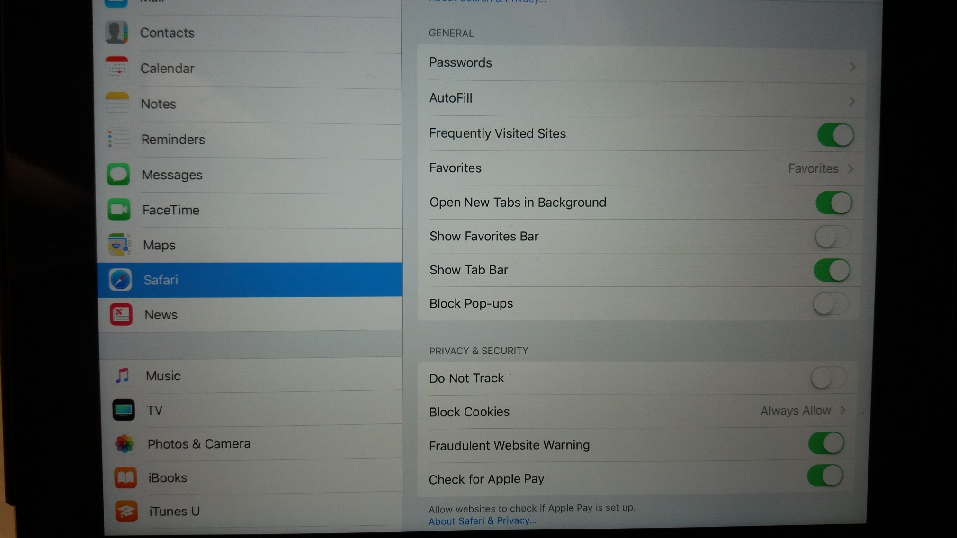
Allow pop-ups for qglobal (iPad)
Under ‘Settings’, select ‘Safari’, make sure that the ‘Block Pop-ups’ button is off (not green)

Slide 10
Log-in to Q-Global
Add new examinee or select examinee if available

Slide 11
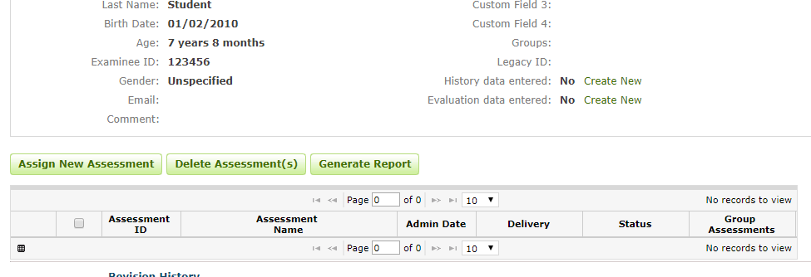
Assign a new assessment for your student

Slide 12
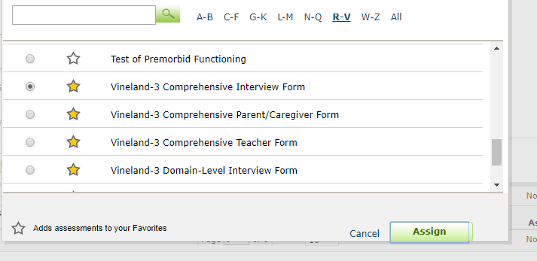
Select the Vineland 3 Comprehensive Interview Form
Click Assign

Slide 13
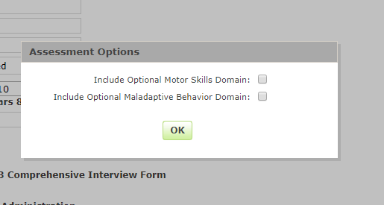
Decide if you want to include the Motor Skills Domain (birth-9) or the Maladaptive Behavior Domain (3-adult) in your assessment

Slide 14
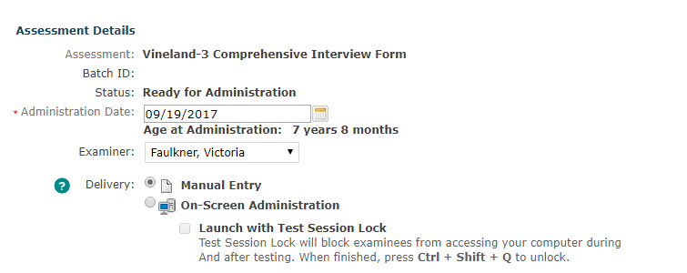
Select the administration date and your name
Click On-Screen Administration

Slide 15
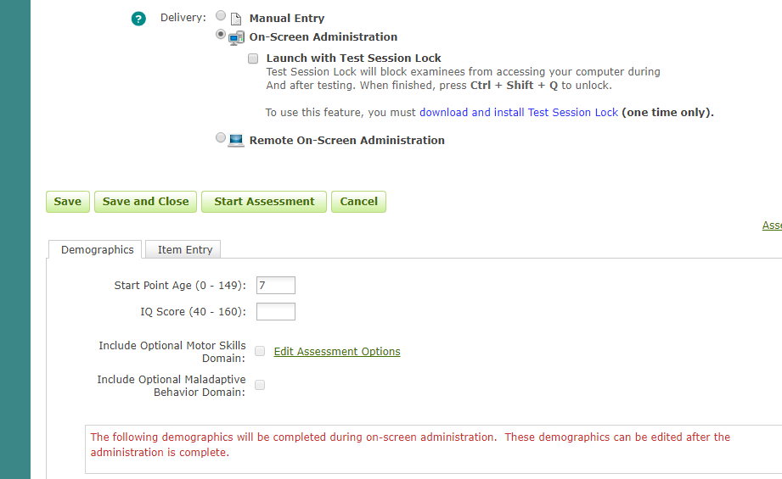
Once age is entered (pre-populated, but changeable), click ‘Start Assessment’

Slide 16
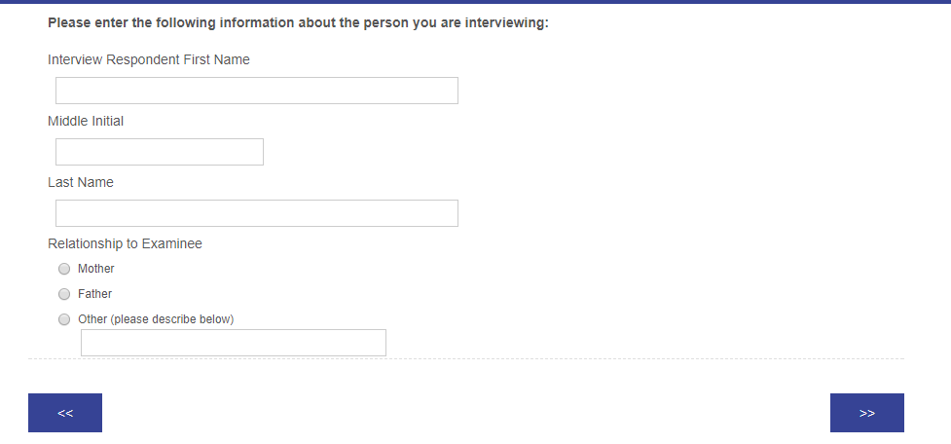
After the instructions page, you will enter information about the respondent

Slide 17
You will see the title of the Domains and the Subdomains as you go through the interview

Slide 18
The items are grouped by categories
As you select the responses, the software will determine if you met the basal and ceiling rules, and will either add additional items or move on to the next category.

Slide 19
Remember: The Vineland is an interview. You do not read the items to the parent. You ask a question that relates to the category and then probe for more detailed information if needed.
The online administration provides ‘Suggested Interview Questions’ that you may ask – or you can make up your own.
The software will enter the student’s name into the question.

Slide 20
If you need more detailed information to score an item, you can click ‘Probe’ to see the suggested probe question – or you can make up your own.

Slide 21
If you are not sure how to score an item, you can click ‘Scoring Criteria’ for information

Slide 22
Feel free to type examples and notes in the ‘Comments or Observations’ box at the bottom of each page

Slide 23
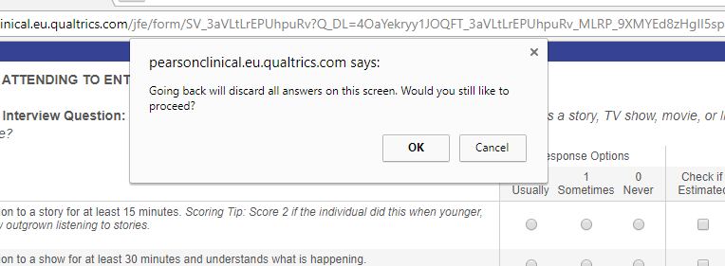
Caution: you are able to go back to a previous page during the administration; however, you will lose the answers that you entered on your current screen.

Slide 24
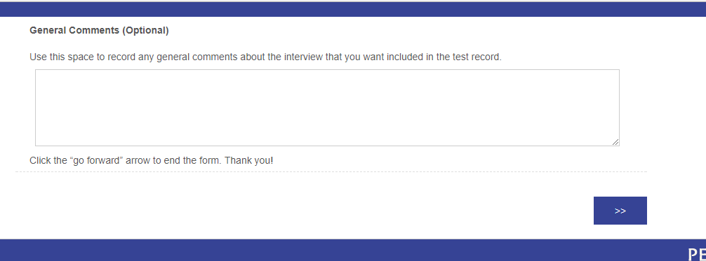
After the last section, you will have a box for ‘General Comments’). Click the “go forward” arrow to end the administration.

Slide 25
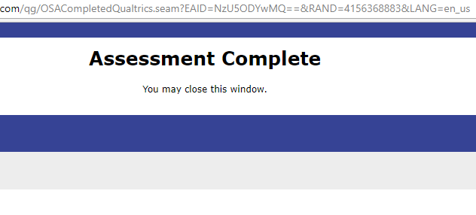
You are all done!

Slide 26
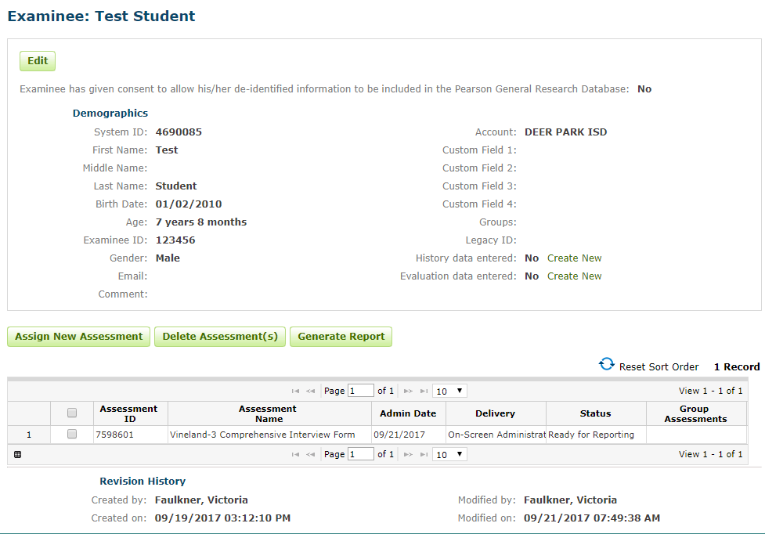
The assessment will now be ready for generating a report

