Slide 1
Lunch and Learn
November 16, 2017

Slide 2
Topics of Discussion
Recording/Reporting special education eligibility with demographic information
How to determine what is the Primary Disability, Secondary Disability, and Tertiary Disability

Slide 3
Recording/Reporting special education eligibility with demographic information
We are currently in ‘Year 1’ of a state-wide recording/reporting system
Student’s eligibility (primary) along with demographic data is collected by the state
Reports are generated with percentages across different categories
These percentages help identify area of significant disproportionality
What we need to do moving forward: ensure we are correctly designating the primary disability condition

Slide 4
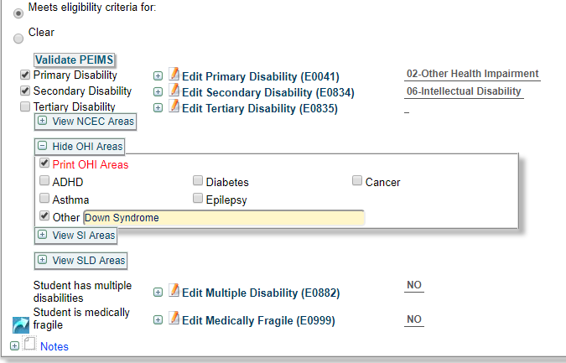
How to determine what is the Primary Disability, Secondary Disability, and Tertiary Disability
If the student has:
Health Related Conditions (except ADHD)
Autism
then that condition would be
set as the Primary.
* Note what OHI area

Slide 5
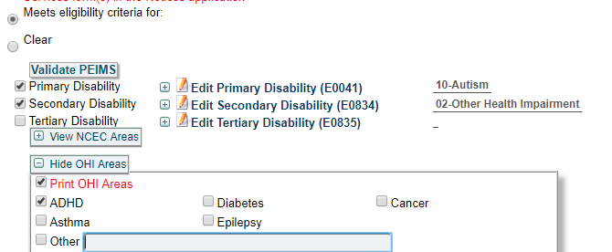
Examples

Slide 6
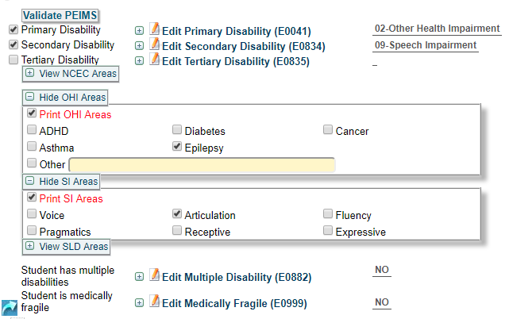
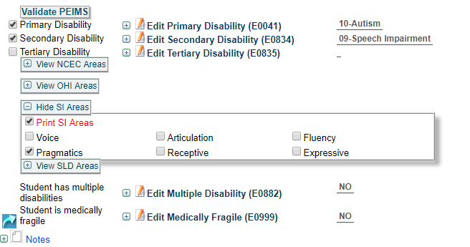
Examples

Slide 7
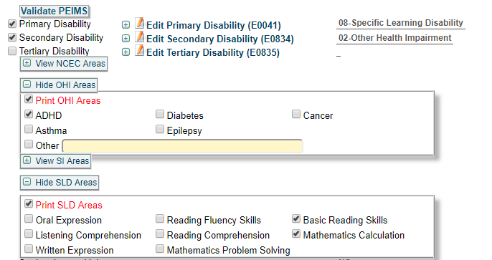
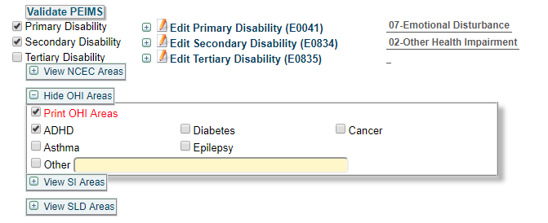
Example

Slide 8
Moving forward…
Do not go back and make corrections
As students come up for re-eval and as you complete initial evals,
Note in the report which disability is primary, secondary, tertiary
When you have the ARD to accept the evaluations, make sure it is recorded properly in the ARD documents.

Slide 9
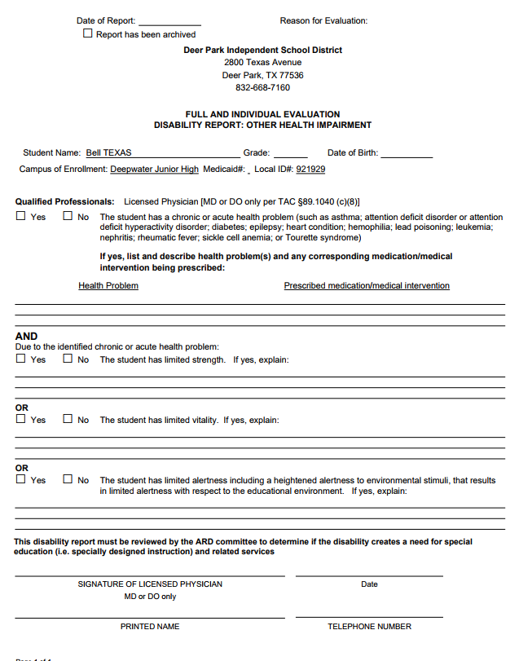
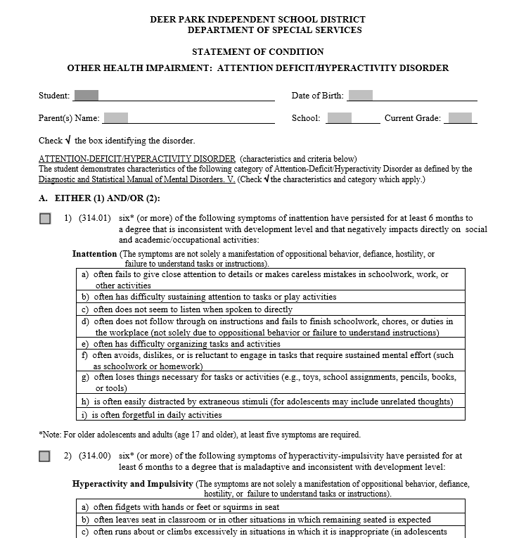
A few reminders
Other Health Impairment
We have two forms (the one in esped and the ADHD form)
Both need to be signed by a Licensed Physician in
order for the student to qualify

