Slide 1
Scoring the DP3

Slide 2
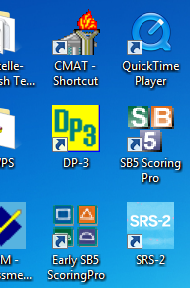
Put DP3 USB drive (purple USB in box above computer) into the scoring computer
Find the DP3 icon on the desktop and open it

Slide 3
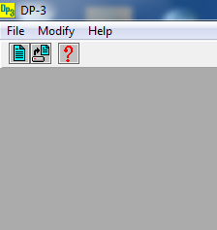
Click on ‘File’ then ‘New’

Slide 4
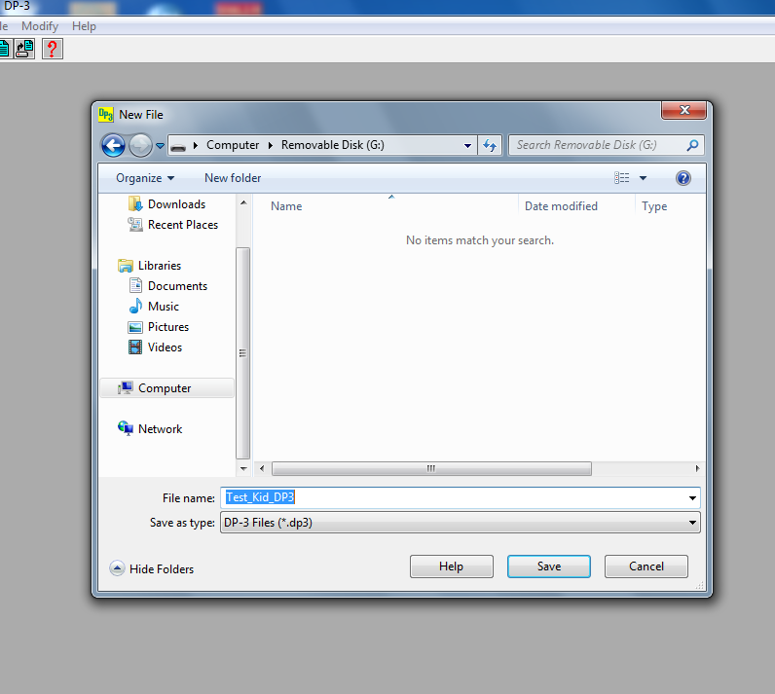
You can save the file to your desktop or to your own USB.
Give a title to your file and then click ‘Save’

Slide 5
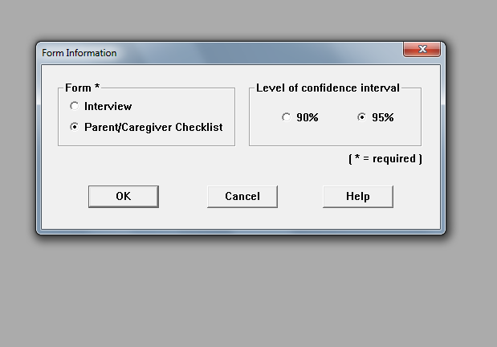
Select the Parent/Caregiver Checklist form then click ‘OK’

Slide 6
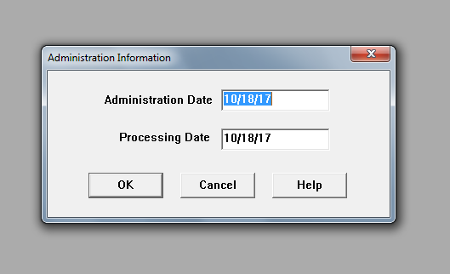
Enter the Administration Date (date you gave it) and the Processing Date (date you are scoring it)

Slide 7
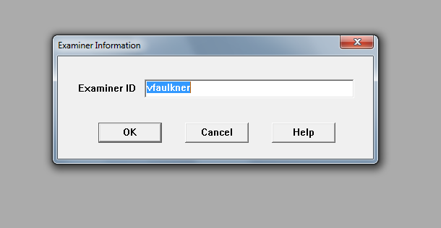
Enter your name/username as the Examiner ID then click ‘OK’

Slide 8
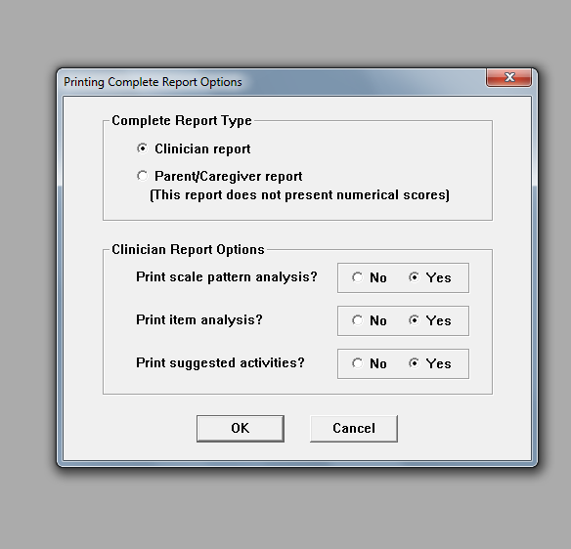
Select the ‘Clinician report’ type then click ‘OK’

Slide 9
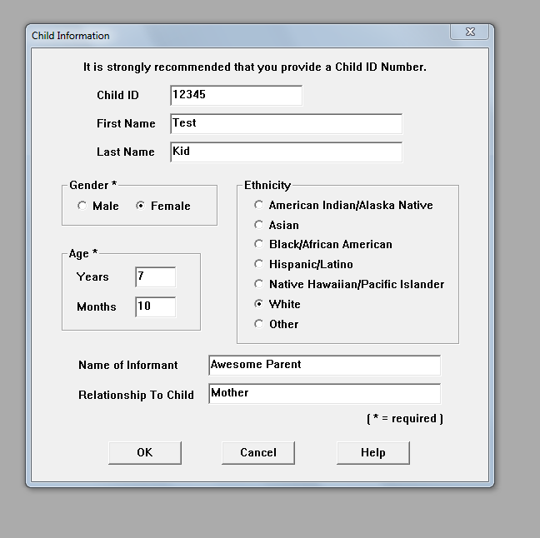
Enter child’s information and name of the informant (person who completed the checklist) then click ‘OK’

Slide 10
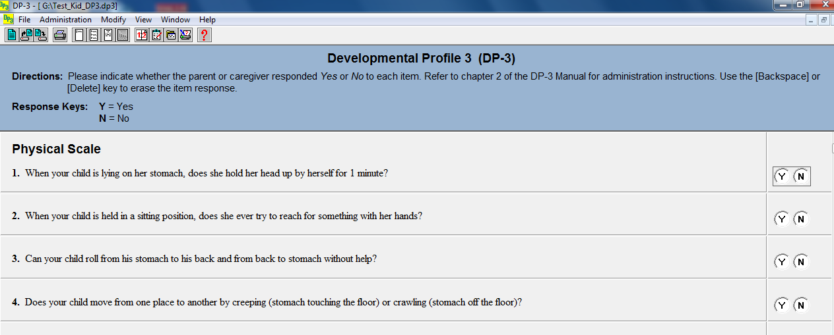
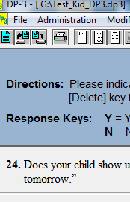
You will now be able to enter in the responses (Y or N). Once you have entered all the responses, click on ‘File’ then ‘Save’

Slide 11
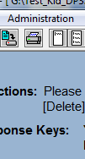
Click on ‘Administration’ and then ‘Complete’

Slide 12
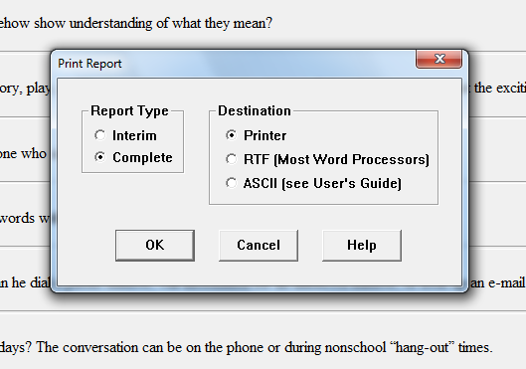
To print your report: Click on ‘File’ then ‘Print Report’. Select ‘Complete’ report type (this will give you the scores and a graph). The ‘Interim’ report is just a list of the responses. Click ‘OK’. Your report will print.

Slide 13
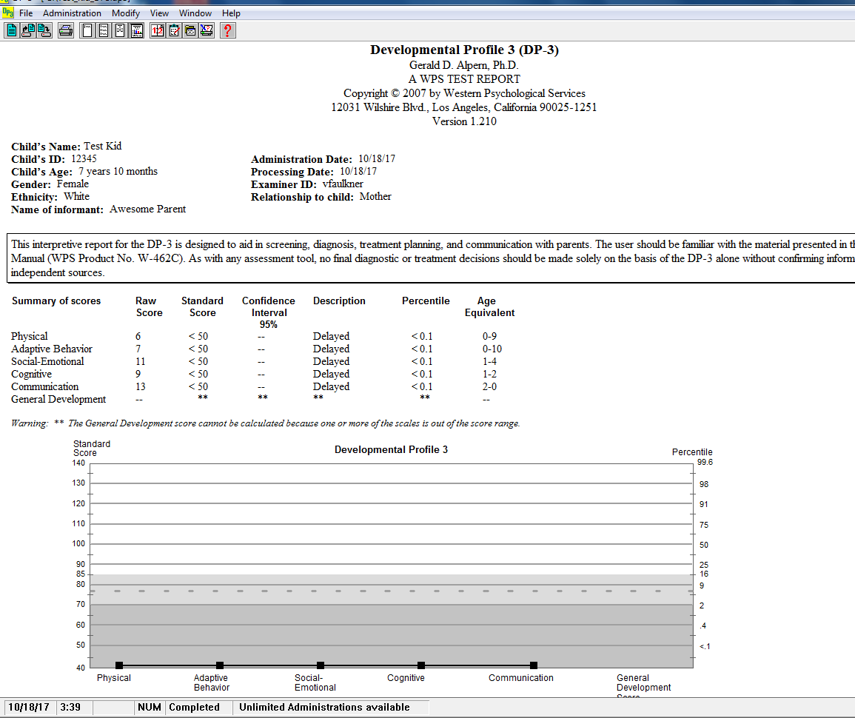
This is what your Complete Report will look like. If you want to view your report on the screen and use the Snipping Tool to take a picture of it, click ‘View’ then ‘Complete Report’

Slide 14
Note: you cannot save the report as a separate document on your USB. The software is required to open your saved file and the software is only installed on the scoring computer. If you need to view/print any additional reports, you can open your saved file on the scoring computer and view/print additional reports.

