Slide 1
JAM 1/18/19
Happy New Year!!

Slide 2
Agenda
Updates
Policies/Procedures/ARD
eSTAR/eSHARS
Questions/Concerns
Celebrations
Communication
Diagnosticians/LSSPs/SLPs – Please stay

Slide 3
Updates
The Guessing Game
Current Referral Numbers
GCASE Law Conference Update
Operating Guideline Online (OGO)
https://stetsonassociates.com/Files/ogonline/login.html

Slide 4
GCASE LAW CONFERENCE
MDR 504/IDEA
Why: Not discriminating on the basis of disability
Who:
Texas – the ARD committee or 504 committee
When:
Within 10 school days of decision to change of placement due to violations of “code of conduct”
Change of placement can be long term or pattern of removals
Two Questions
Was the conduct the direct result of school’s failure to implement the IEP?
Was the conduct caused by, or had a direct & substantial relationship to, the child’s disability?
Don’t ever forget to review the first question. Insure that the student’s IEP/BIP/Accommodations are being followed.

Slide 5
MDR Continued
Don’t for get Notice of Procedural Safeguards (no later than the date on which the decision to take disciplinary action is made)
Review all required data
If consensus is not reached, the district must make the decision; parent may challenge
Even in “special circumstances” an MDR must be conducted
Understand your legal burden
The burden is on the party challenging the placement documentation must be included.
Don’t punishing student for disability-related conduct
Conduct FBA
Implement BIP or review and adjust BIP
Return child to last placement

Slide 6
GCASE continued
REMINDER: PWN must be accompanied by a copy of Procedural Safeguards Notice
86th Texas Legislature upcoming bills
D.C. vs Klein ISD (November 16, 2018)

Slide 7
Policies/Procedures/ARD
REMINDER: PWN must be accompanied by a copy of Procedural Safeguards Notice.
New REED Review
Related Services
APE
Speech
Documenting Services
Service Logs need to be uploaded into eSTAR at the end of each semester

Slide 8
Policies/Procedures/ARD continued
Examples of documenting time
210 min. over 7 wks. Per grading period
7-30 min. sessions per grading period
Direct and Consultation must be documented separately
Services logs: must be kept with dates and times of services

Slide 9
eSTAR/eSHARS
Printing of ARDS
Use Chrome for eSTAR
Firefox seems to be having issues
Double check the printed ARD prior to handing in
some have been turned in unreadable
Please print ARDs one sided
Doubled sided causes scanning and duplicating issues

Slide 10
Questions/Concerns

Slide 11
Celebrations
Welcome Evelyn Gorman
Welcome Lincoln Lucio

Slide 12
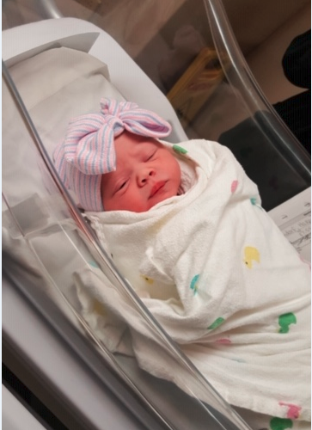
Celebrations
Annie Rose Deutschendorf

Slide 13
Communication
During conversation you may find yourself stuck, the conversation just isn’t happening or not going well.
#1 Get Unstuck:
Identify where you’re stuck
What bad results do you want to fix?
What good Results are you currently unable to achieve?
What problem are you always trying to fix?
What do you complain about at home and at work?
#2 Unbundle with CPR:
Identify where you’re stuck

Slide 14
Communication
During conversation you may find yourself stuck, the conversation just isn’t happening or not going well.
#2 Unbundle with CPR: break it down into various parts
Content: a single instance of a problem. If either the action itself or its immediate consequences is the issue, you’ve got a content problem.
Pattern: a recurring problem - pattern of behavior over time
Relationship: how the problem is affecting your working relationship – e.g. trust is suffering or competence is in question.

Slide 15
Table Talk Case
Your boss has grown accustomed to asking you to produce a report for her. She asks you because you understand how put the report together due to your technology and databased background. To make it worse, it is always last minute and it’s very time consuming. Today she asks you at 11:00 a.m. to have a specific report to her by 3:00 today. To top it all off you don’t believe the information will provide any help or result in action and the time frame is too condensed.
But she’s your boss, and if she wants it, she should get it
right?

Slide 16
Table Talk
At your table discuss and name
Content:
Pattern:
Relationship:

Slide 17
Diagnosticians/LSSPs/SLP (please stay)
Use of New REED and signatures
If part of the ARD make 2 copies of the signature page and attach one copy to the REED (REED is filed under Assessment and requires signatures)
If REED becomes the new FIE it must have signatures
Dyslexia table review
Handbook Link: https://tea.texas.gov/academics/dyslexia/
Supported Decision Making (check box appears to be there now)

